Slide 1
Assignment – 7 (Webserver, DB, ALB)
Labs
Build your VPC and launch a web server.
Build your DB server and interact with your DB using an APP.
Scale and load balance your architecture.

Slide 2
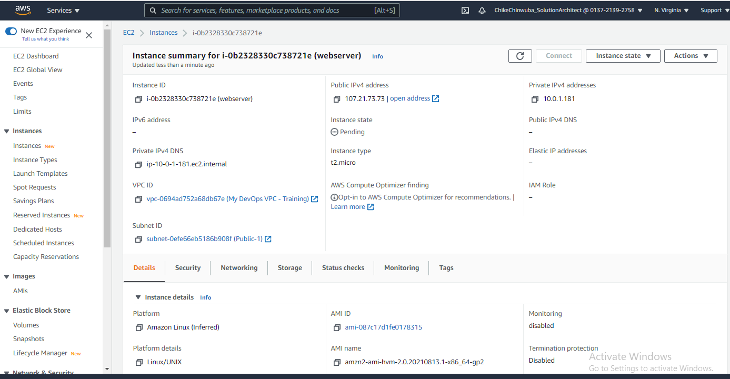
EC2 Instance with Private and Public IPs

Slide 3
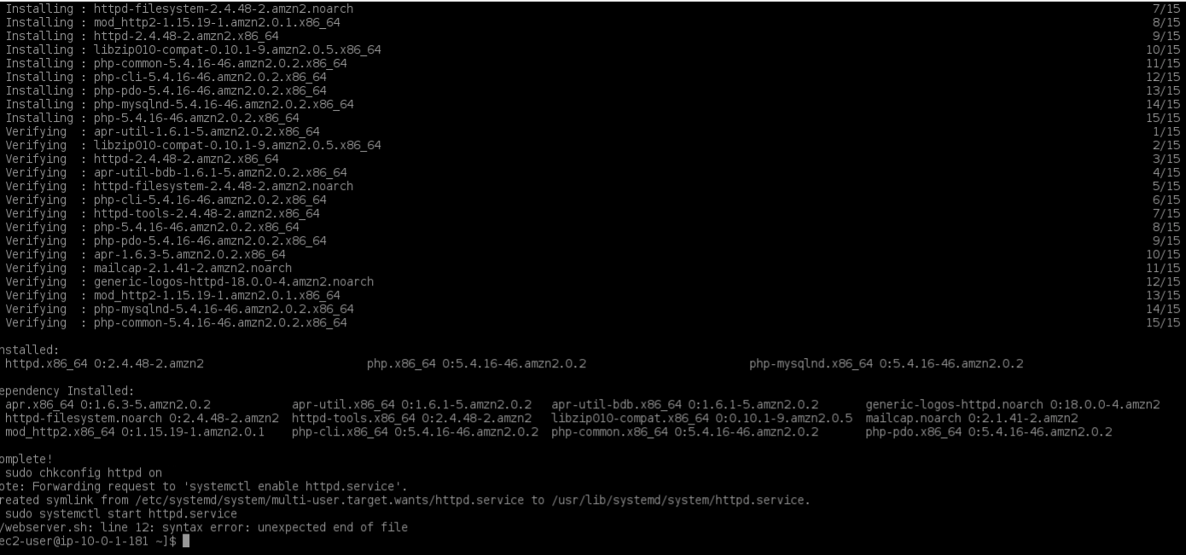
Execute ./webserver.sh

Slide 4
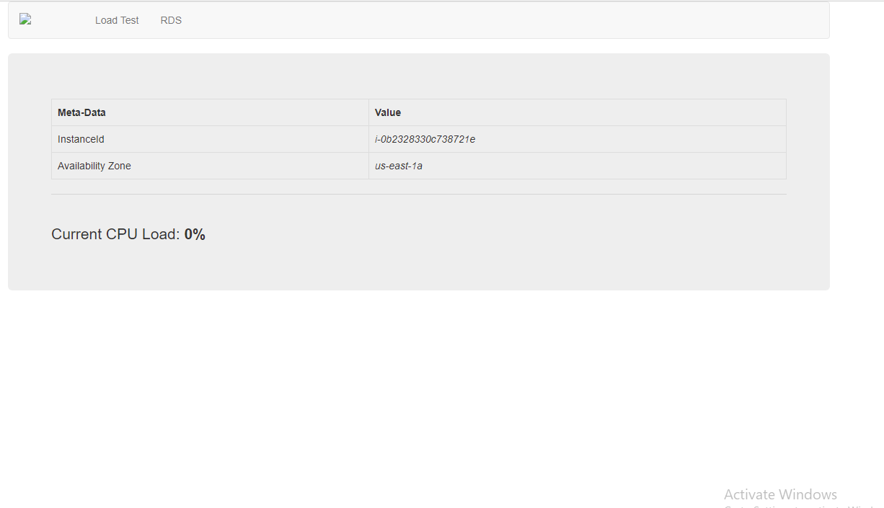
Webserver page connection

Slide 5
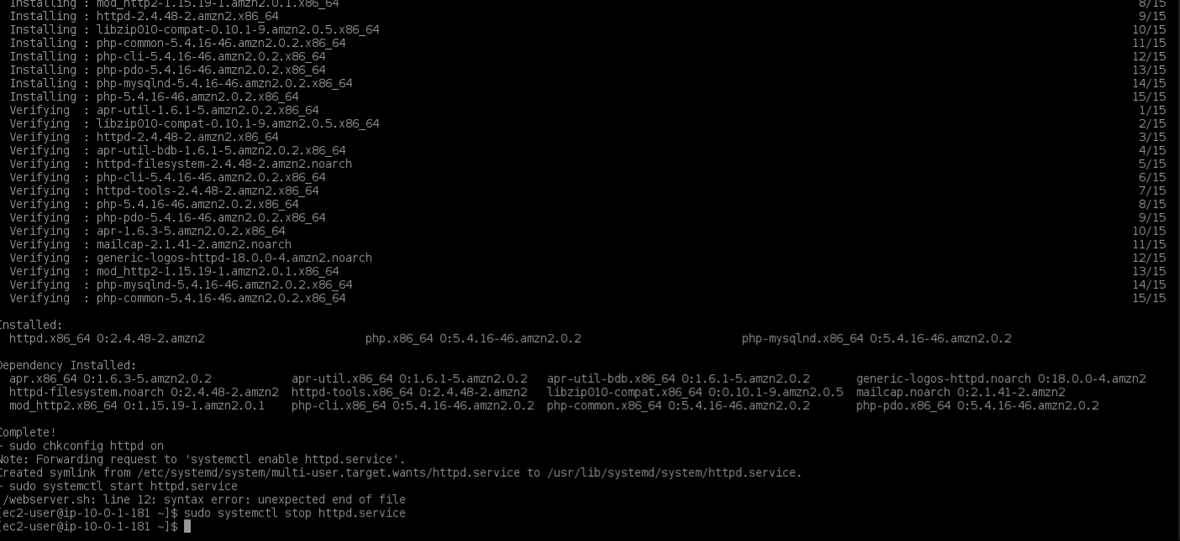
STOP systemctl httpd.service

Slide 6
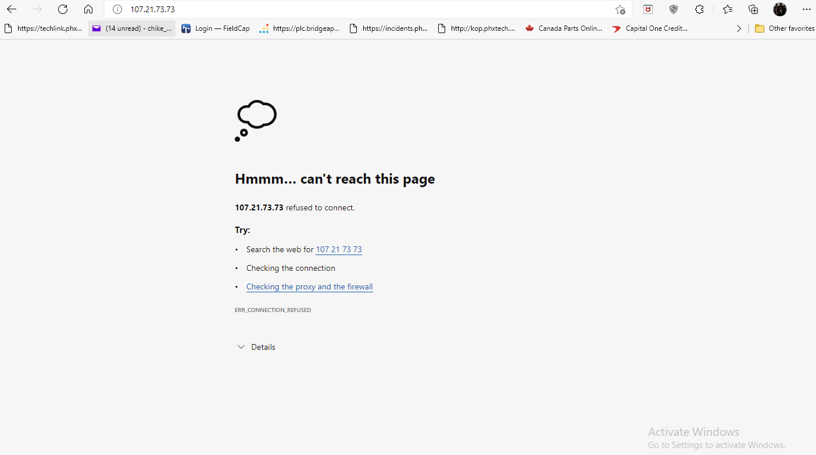
No httpd Connection

Slide 7
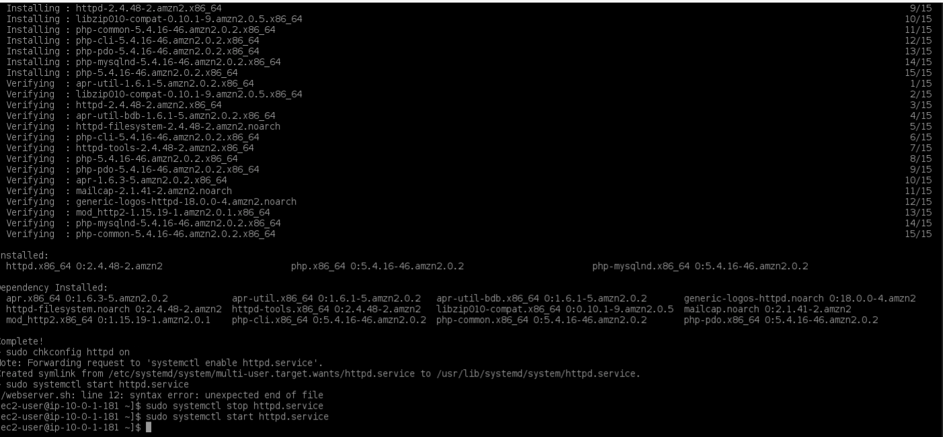
Start systemctl httpd service

Slide 8
Webserver page Connection

Slide 9
Labs
Build your VPC and launch a web server.
Build your DB server and interact with your DB using an APP.
Scale and load balance your architecture.

Slide 10
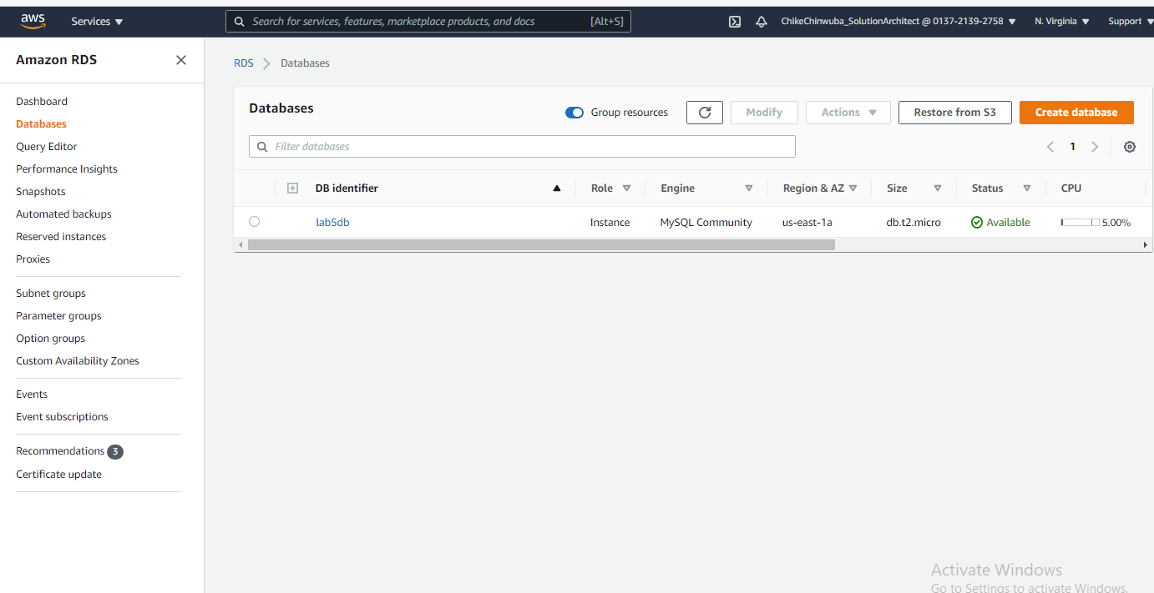
Database Created

Slide 11
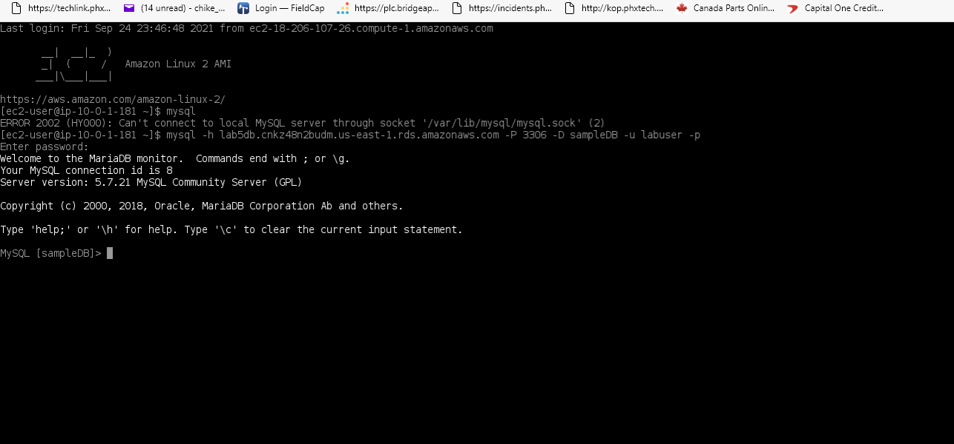
Database Connected

Slide 12
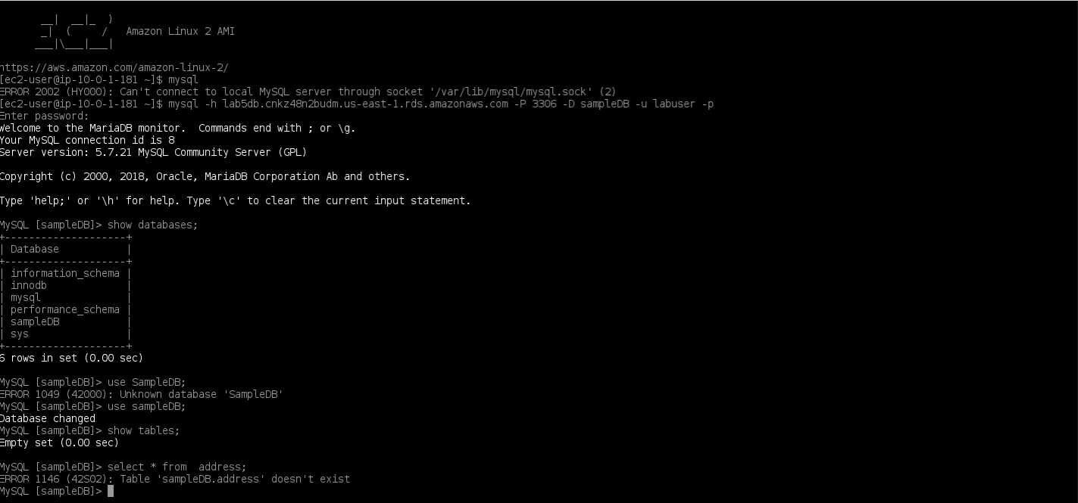
Some commands in Mysql

Slide 13
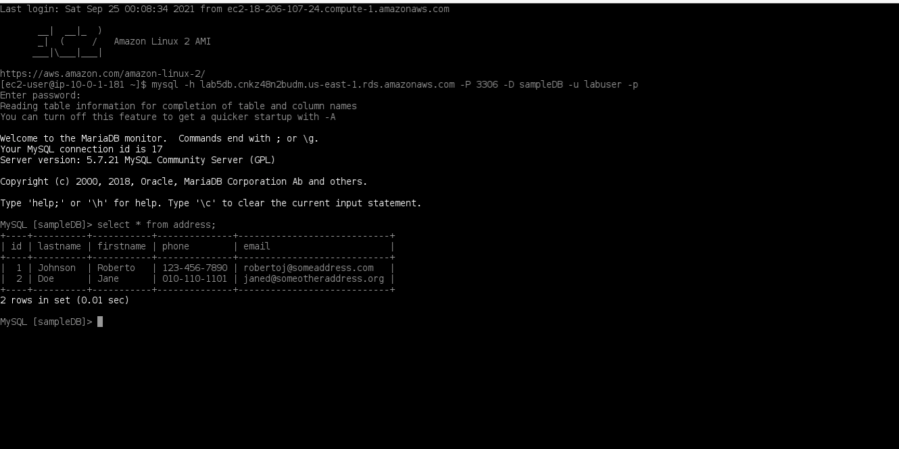
CLI showing address book

Slide 14
Labs
Build your VPC and launch a web server.
Build your DB server and interact with your DB using an APP.
Scale and load balance your architecture.

Slide 15
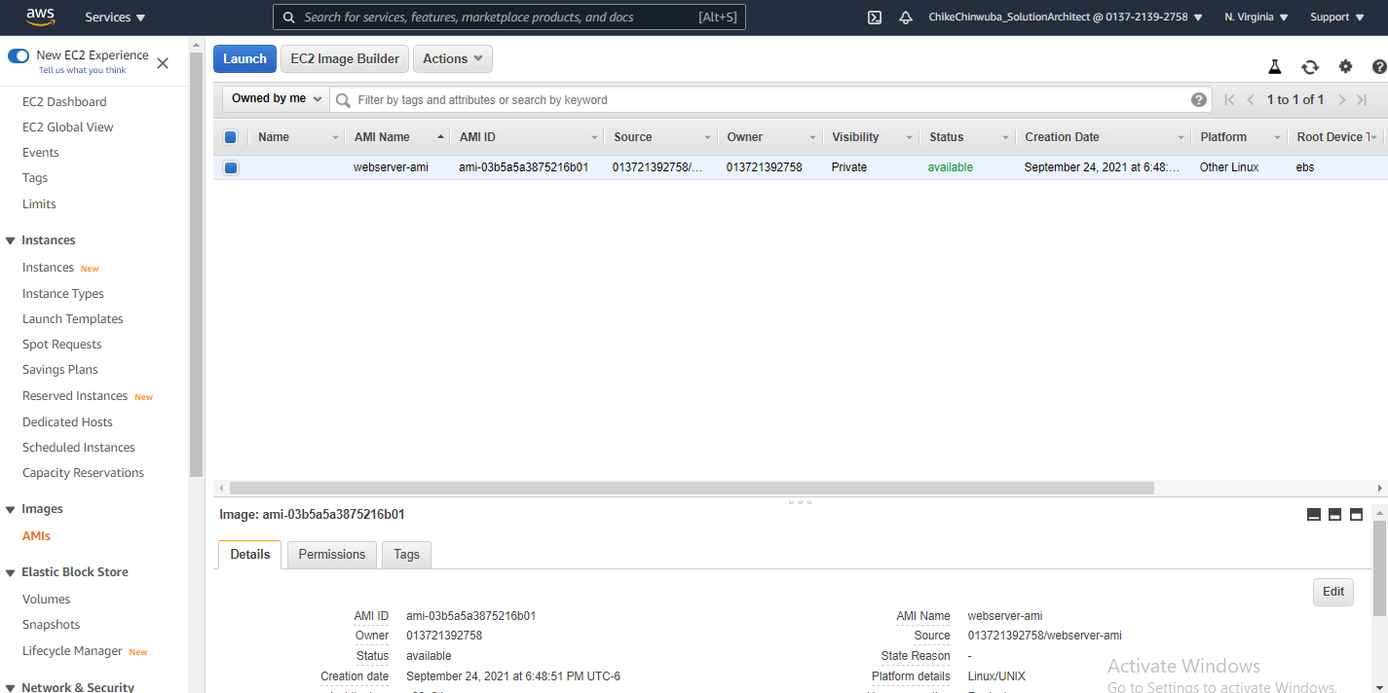
AMI Created

Slide 16
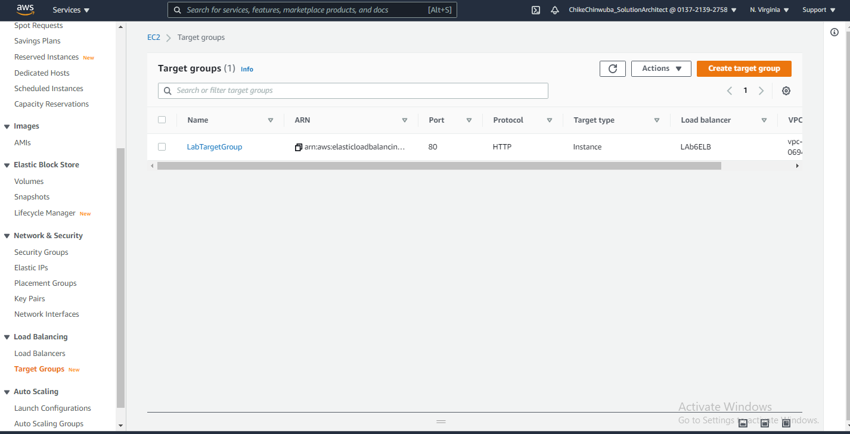
Target Group

Slide 17
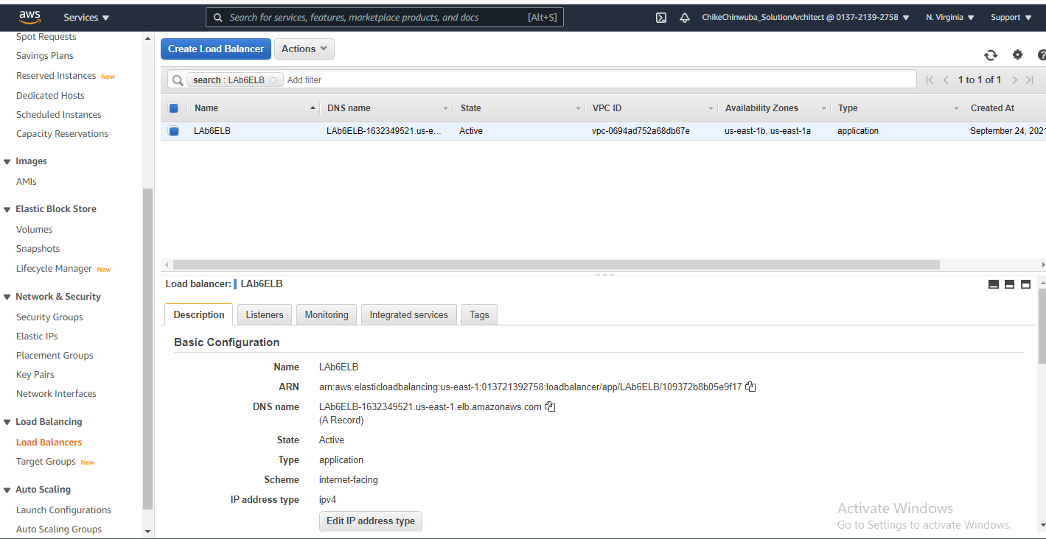
Load Balance

Slide 18
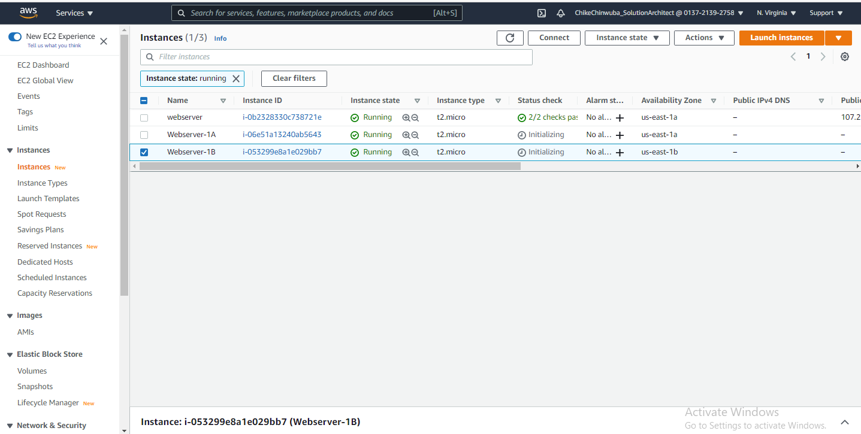
ASG – 2New EC2 Instances Running

Slide 19
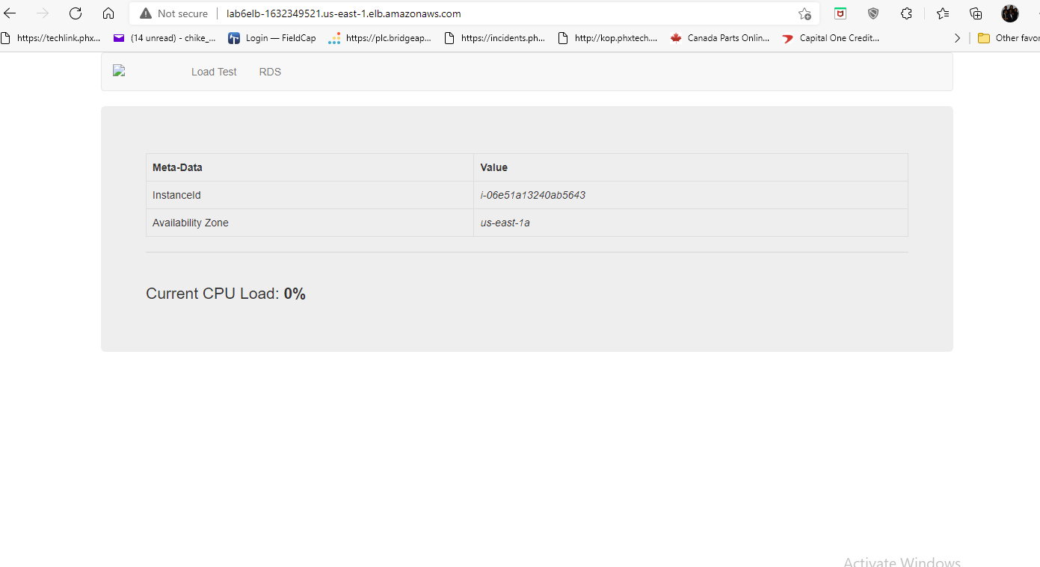
Load Balance traffic to us-east-1A

Slide 20
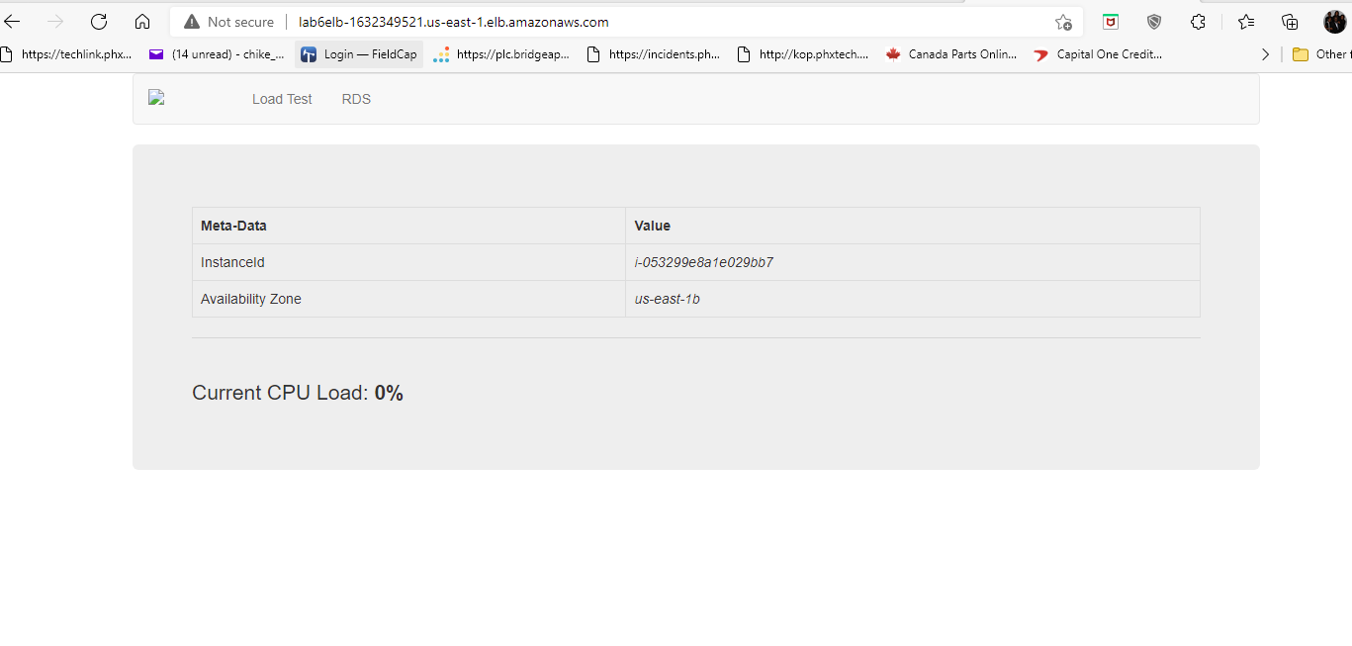
Load Balance traffic to us-east-1B

Slide 21
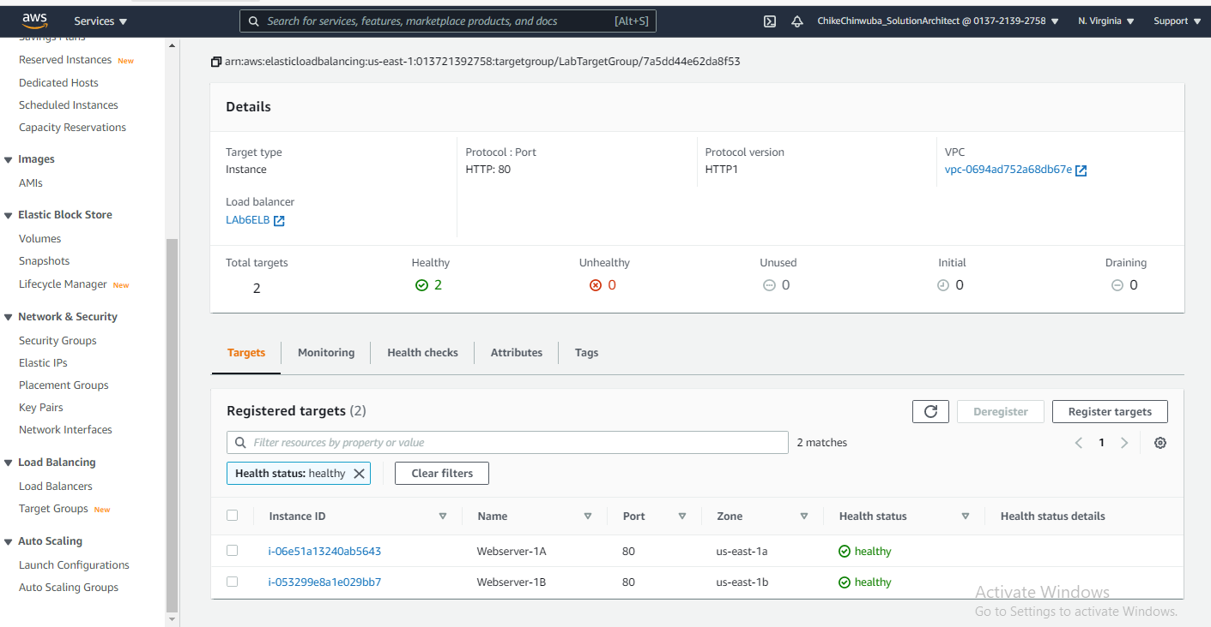
Health Check Passed

Slide 22
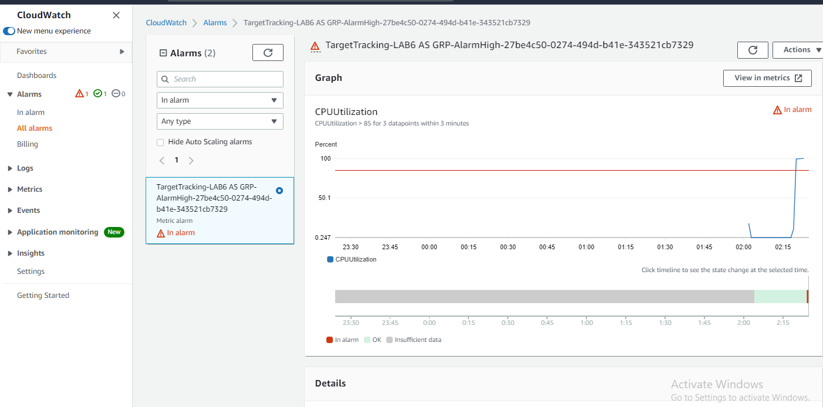
CPU > 85% InAlarm - Cloudwatch

Slide 23
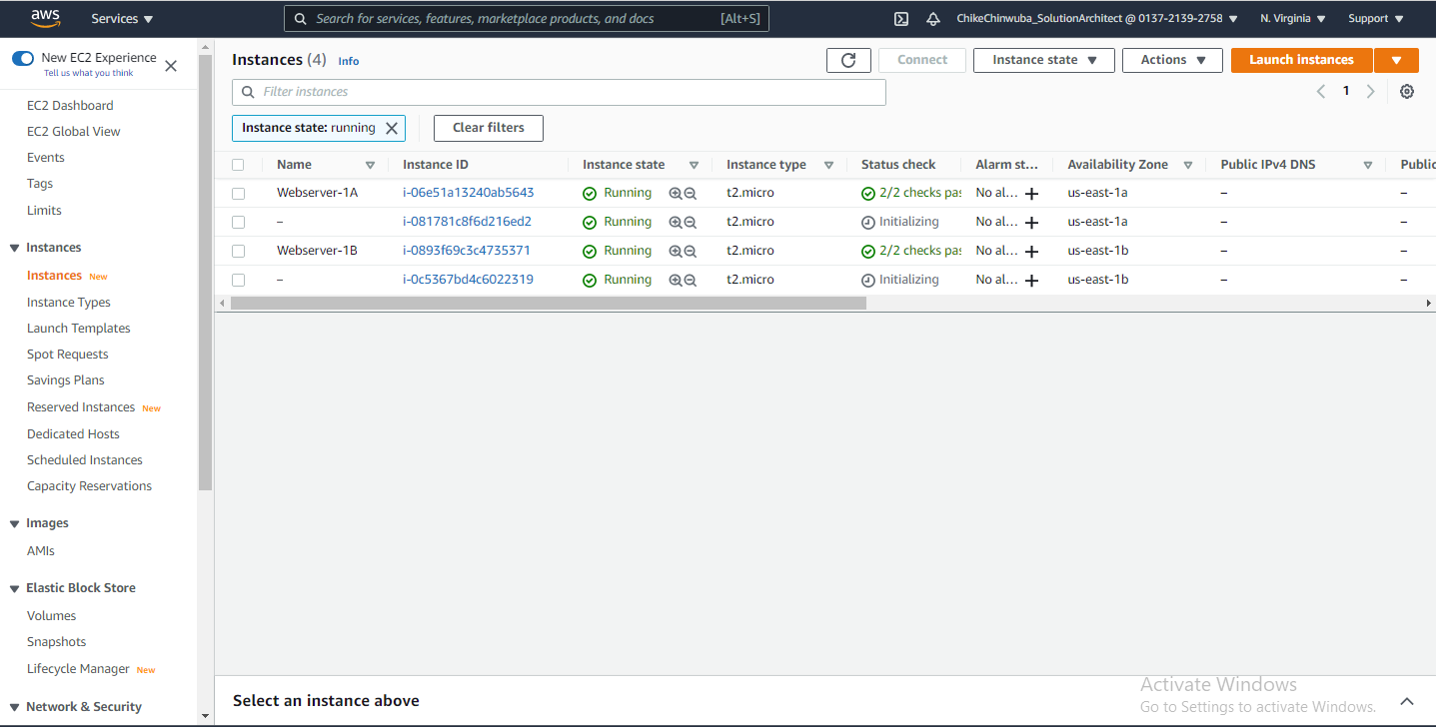
ASG triggered more Instances

Slide 24
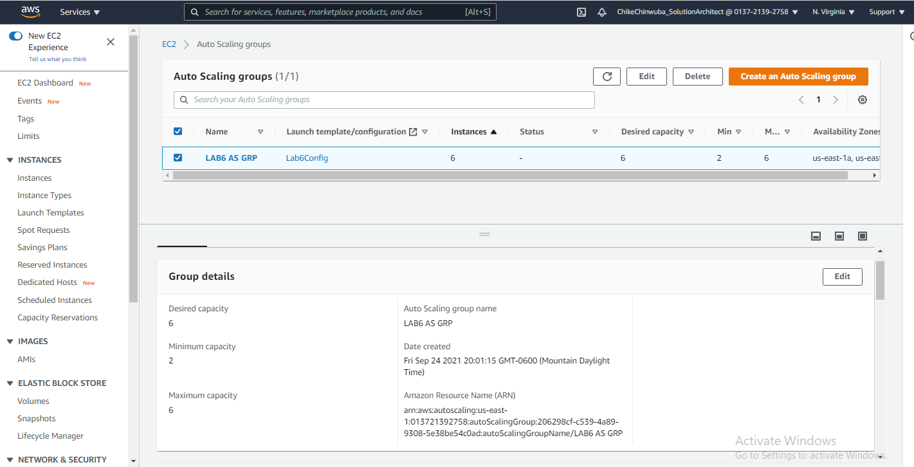
ASG reached maximum Instances

